Slide 1


SPRINT 1 EVALUATION
OLYMPICS ANALYSIS
(Batch - BI V7 MS Azure 15th Oct – Virtual Onboarding)
Aditya Gupta | 46045175

Slide 2
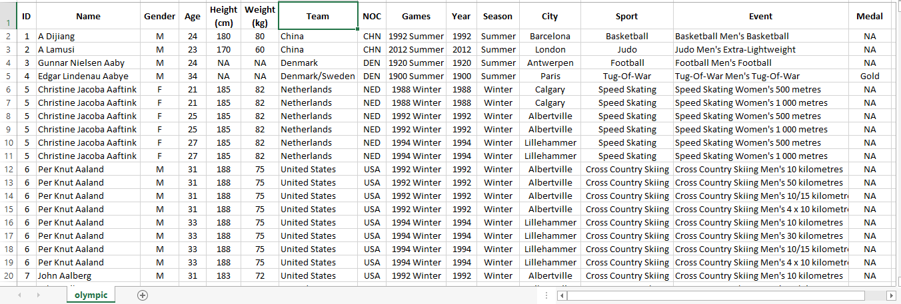
Introduction
Olympics history is given from 1896 – 2016 with all details of events, players, country and medals according to season (Summer and Winter).

Slide 3

Aim
To perform ETL operation and meet the following analysis goals for this dataset.
Goals Statements:-
Extracting the raw dataset, performing cleaning, partition, transformations and loading.
Aggregations on Medals
Medals won by player.
Medals won in a particular Sport.
Medals won in Year.
Medals won by Country.
Top 3 Players with MAX medal.
Country Participation in Olympic over Year.
Event Participation over Year.
Ratio of Athletes Participation by gender over Year.
Year wise Sport Analysis.
Sport played over year.
Sport First Played, Last Played in which year.
Newest Sport in Olympics.
Rank of country on the basis of medals.
Comparison b/w country over medals.

Slide 4
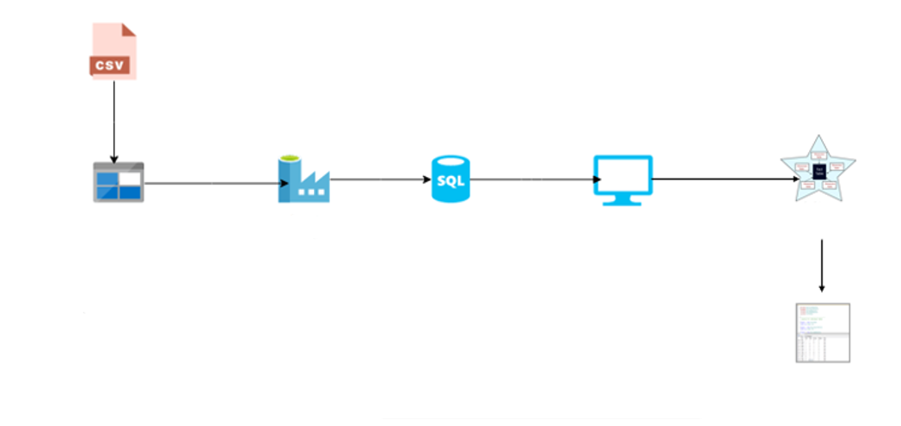
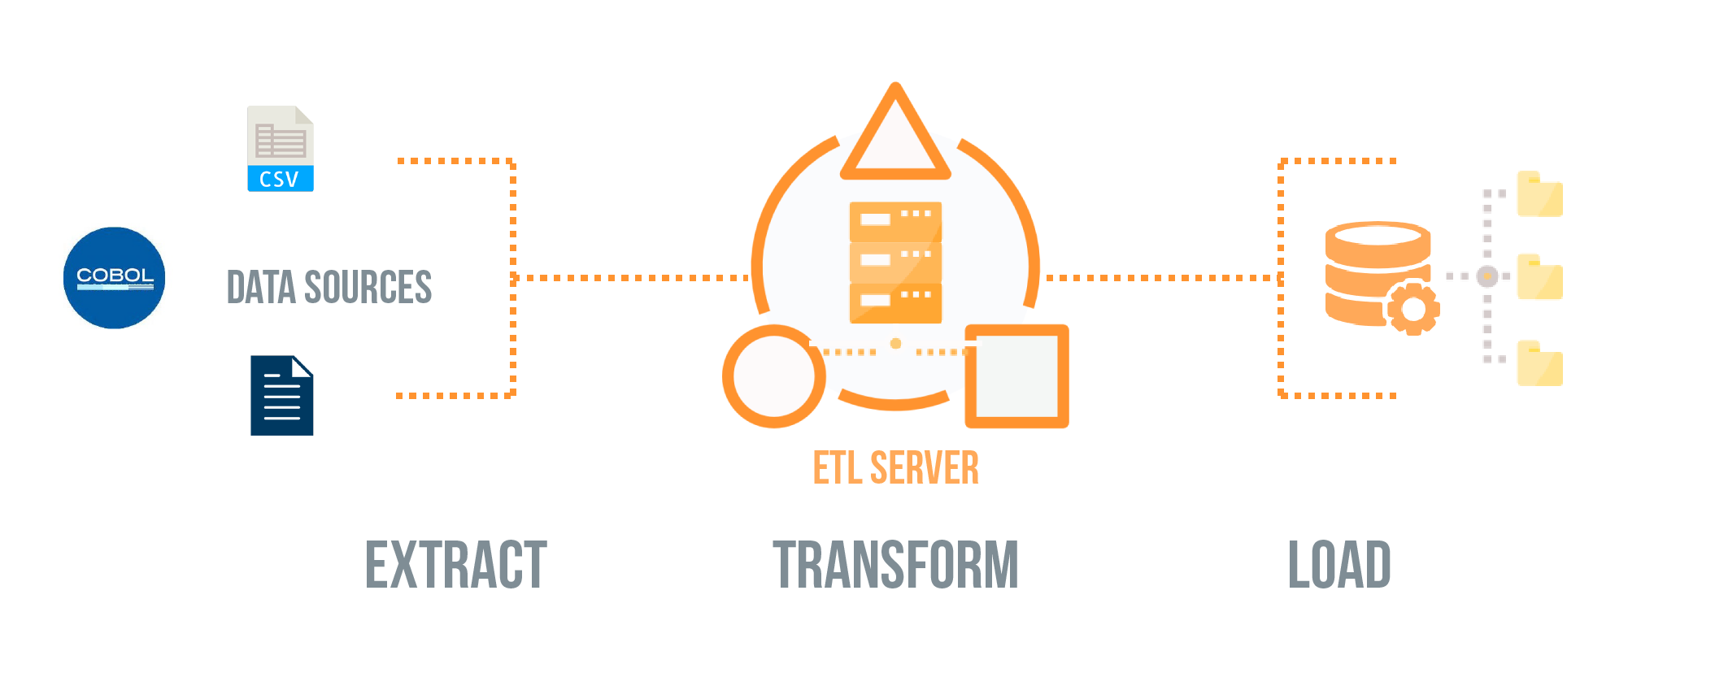
Project Architecture
Step 1
Step 2
Step 3
Step 4
Step 5
Azure Data Factory
Azure sql database
Sql Server Management Studio
Star Schema
Blob
Step 6
Upload
ETL
Cloud
On-Premises
Retrieving Data

Slide 5

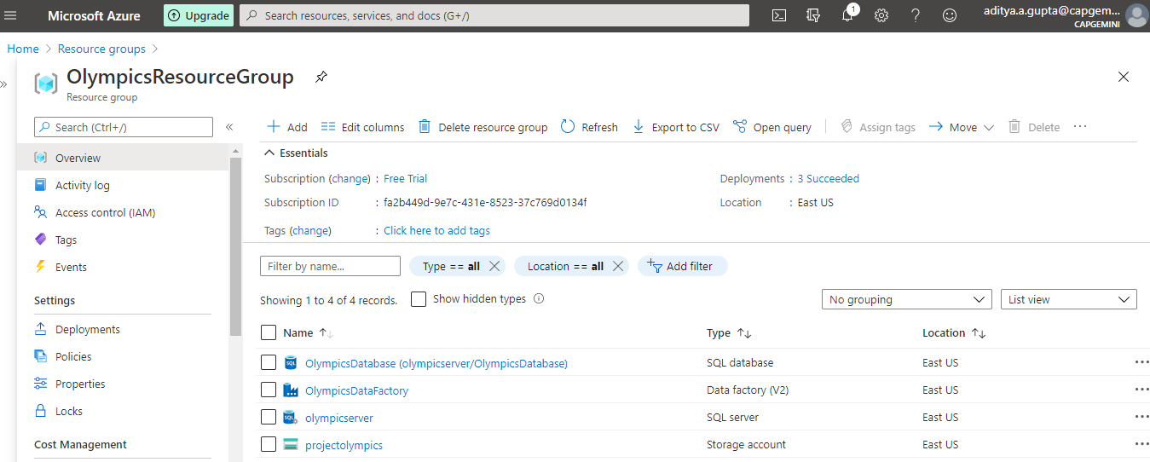
1. ETL Process
Creating a Resource group
Resources required

Slide 6

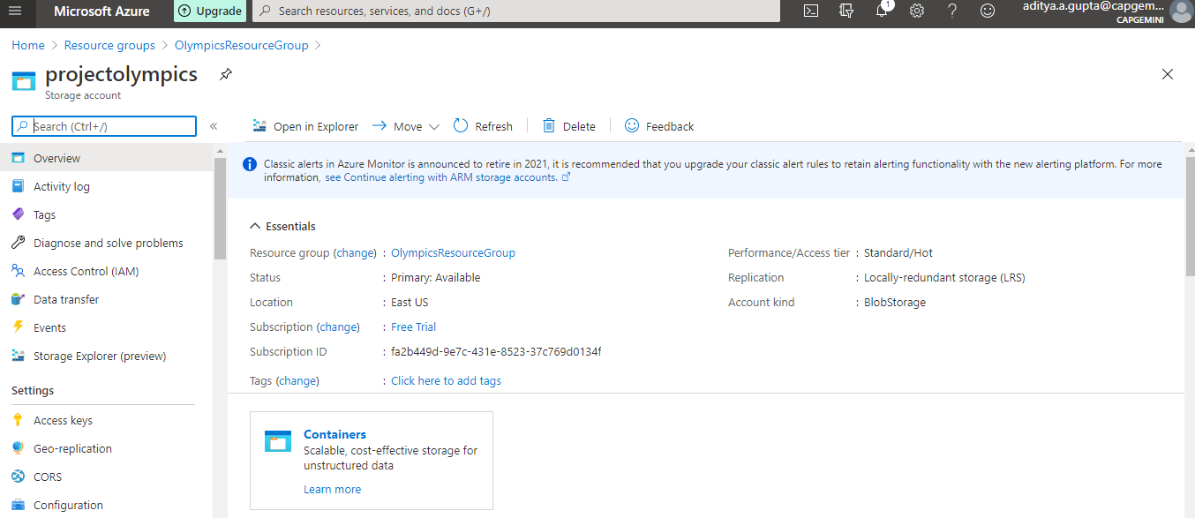
Creating a Blob Storage Account

Slide 7
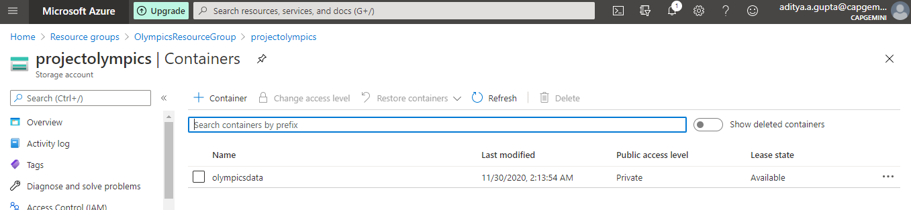
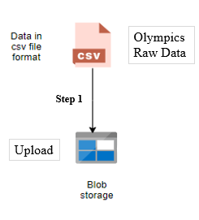
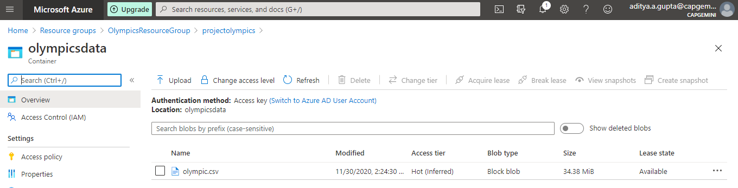
Creating Container inside Blob Storage Account
Container
Upload file into blob container
Uploading CSV file in Container

Slide 8

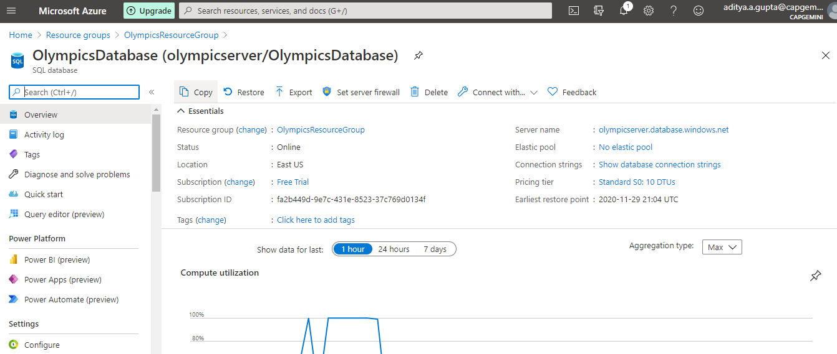
Creating an Azure Sql Database

Slide 9

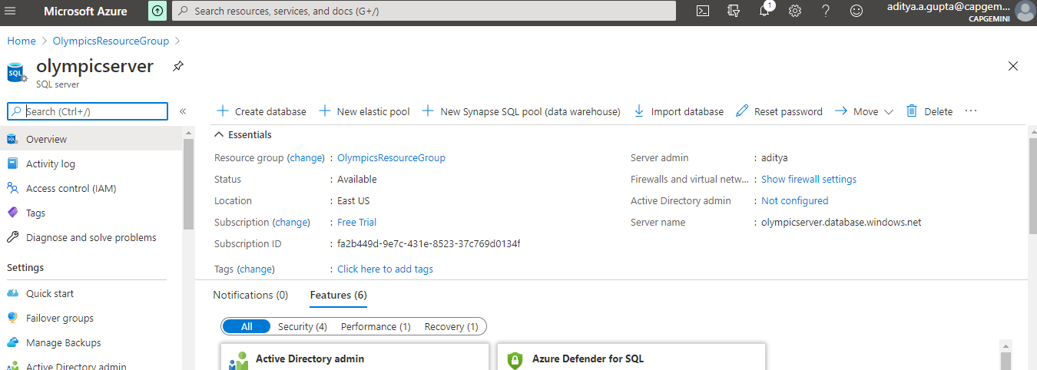
Creating a Sql Server
SQL Server allows multiple clients to use the same database.
There is need to control access to shared data, to ensure data integrity—when multiple clients update the same data, or clients attempt to read data that is in the process of being changed by another client.

Slide 10

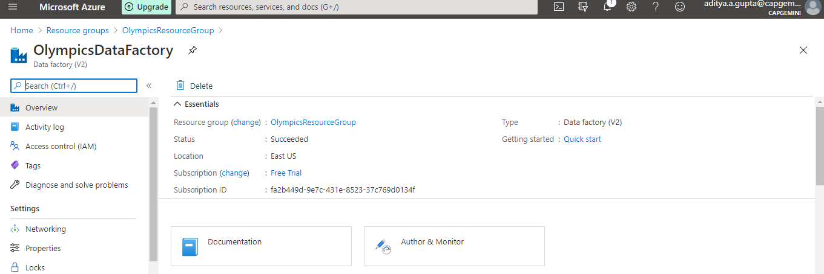
Creating an Azure Data Factory
Use - Orchestrating data movement and transforming data

Slide 11
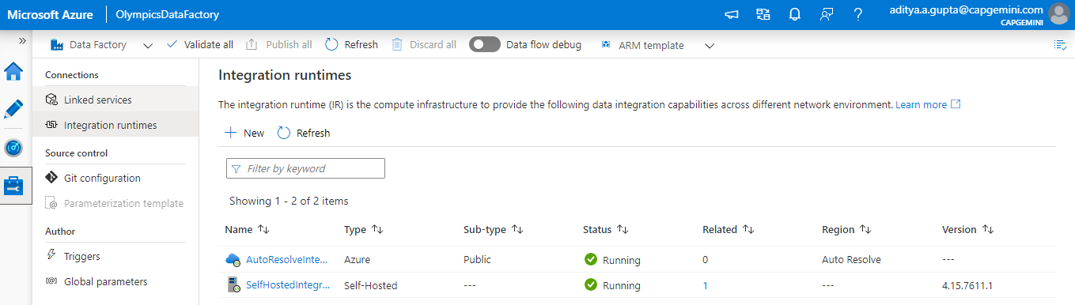
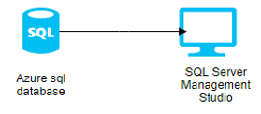
Adding Self-Hosted Integration Runtime in ADF
Self-hosted Integration Runtime can run copy activities between a cloud data store and a data store in a private network.

Slide 12
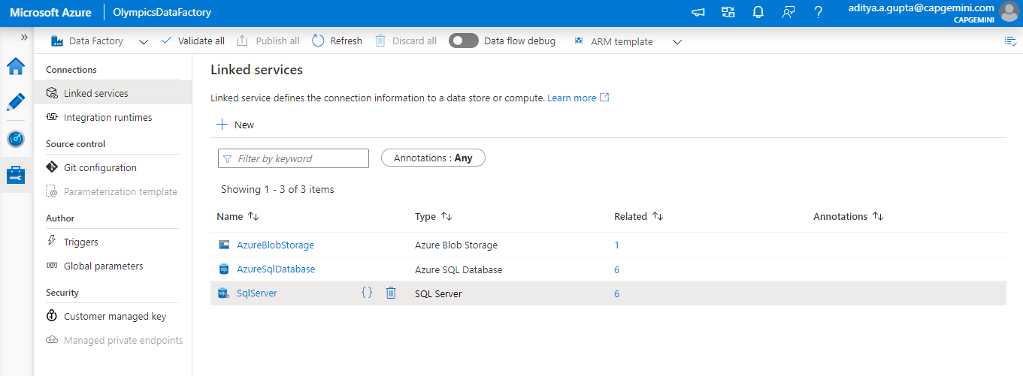

Adding Linked services in ADF
AzureBlobStorage - To create a connection with Blob Storage Account
AzureSqlDatabase - To create a connection with Azure Sql Database
SqlServer - To create a connection with Sql Server on Premises

Slide 13
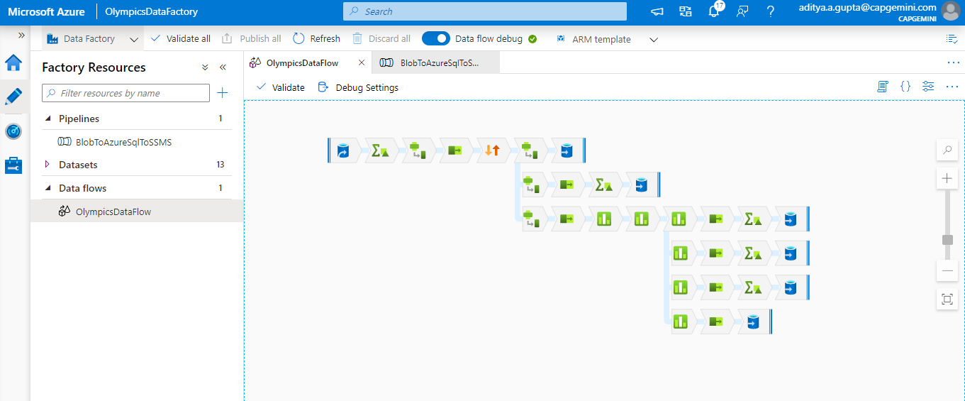
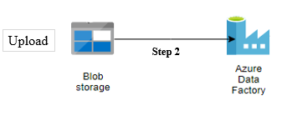
Creating Dataflow in ADF for Extracting, Cleaning and Transformations and load into Azure Sql Database

Slide 14
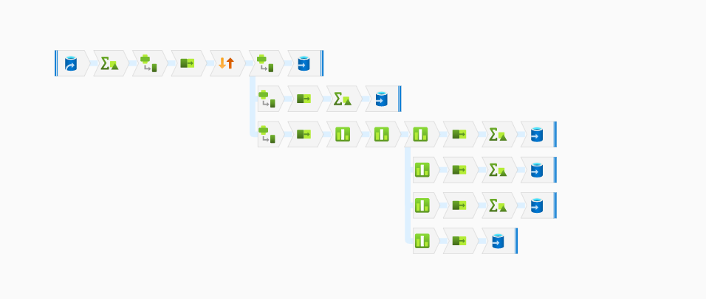
Adding Year of Birth Column
Dealing with Null, Spaces, Gender (Female for F and Male for M)
Olympic Data after cleaning
Unique Data
IDWiseSorting
Selecting Players Data
Unique data
1
2
Player Details
Game
Details
Olympic
raw data
from Blob
3
Dimension
Tables
Event
Details
4
Selecting Relevant Data
Adding Branches for Partitions
5
Medal
Details
Selecting Game Data with Player ID
6
IDs Relationships
Fact
Table
Adding GameID , EventID, MedalID columns respectively based on Dense_Rank () function to define relationship with PlayerID
Selecting IDs

Slide 15
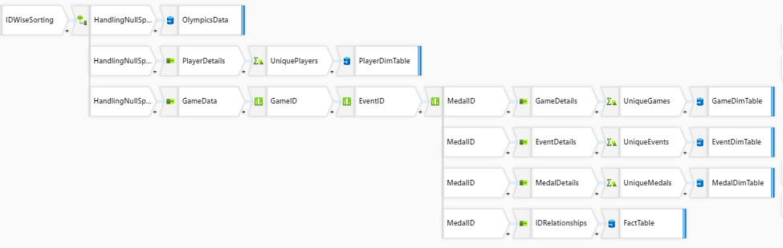
Cleansing
& Transforming
Partitioning

Slide 16
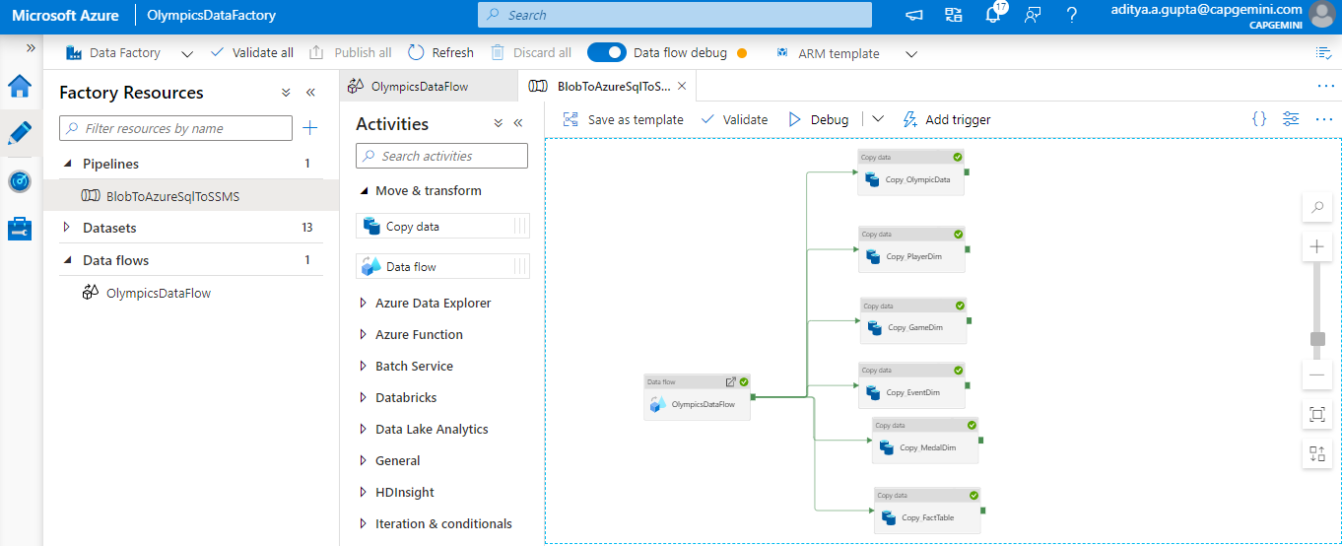
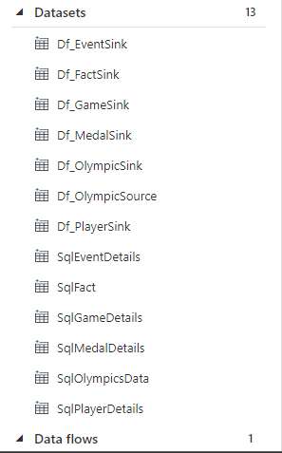
Creating Pipeline to run dataflow and copy activities from Azure sql to SSMS
Dataflow
Pipeline

Slide 17
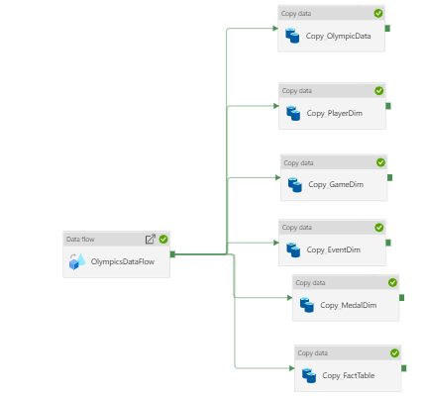
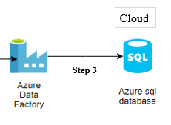
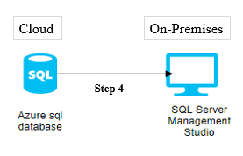
Copy Olympic Data,
Dimension and Fact Tables
from Azure Sql
to SSMS

Slide 18
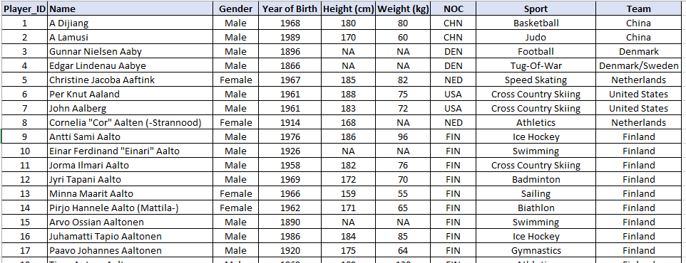
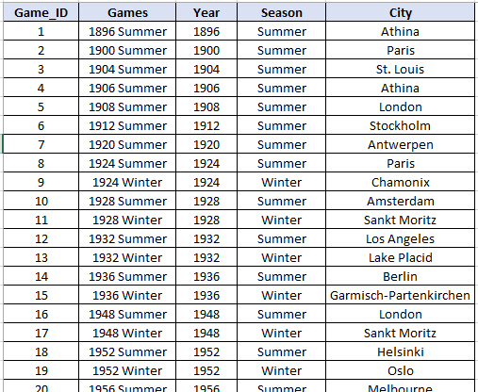
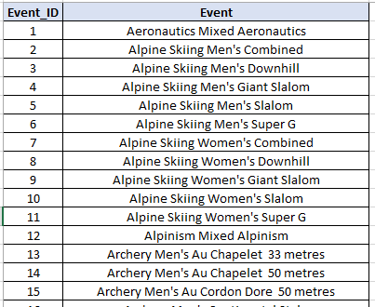
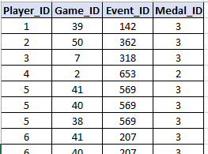
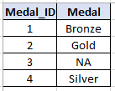
Dim_PlayerDetails
Dim_GameDetails
Dim_EventDetails
FactTable
Dim_MedalDetails

Slide 19
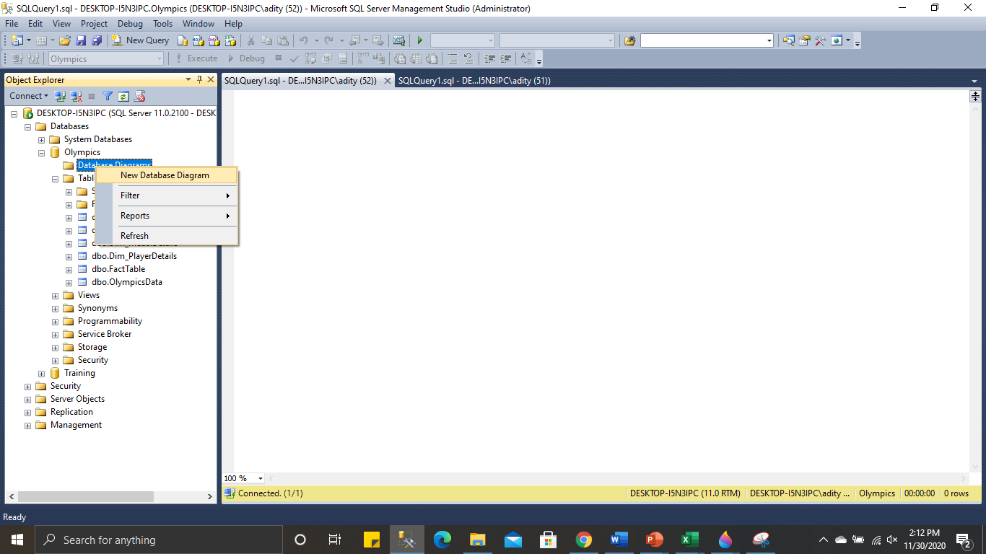
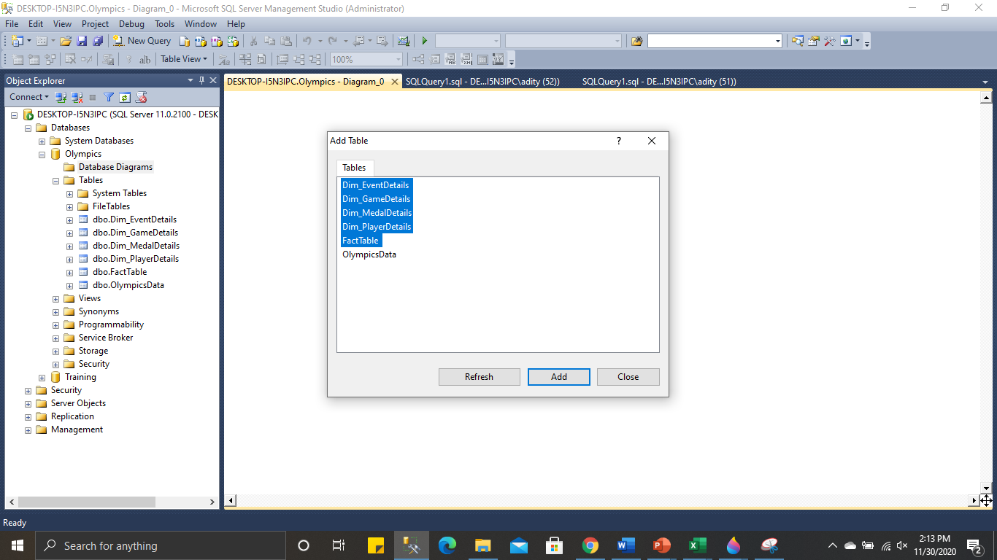
Creating Star Schema using SSMS

Slide 20
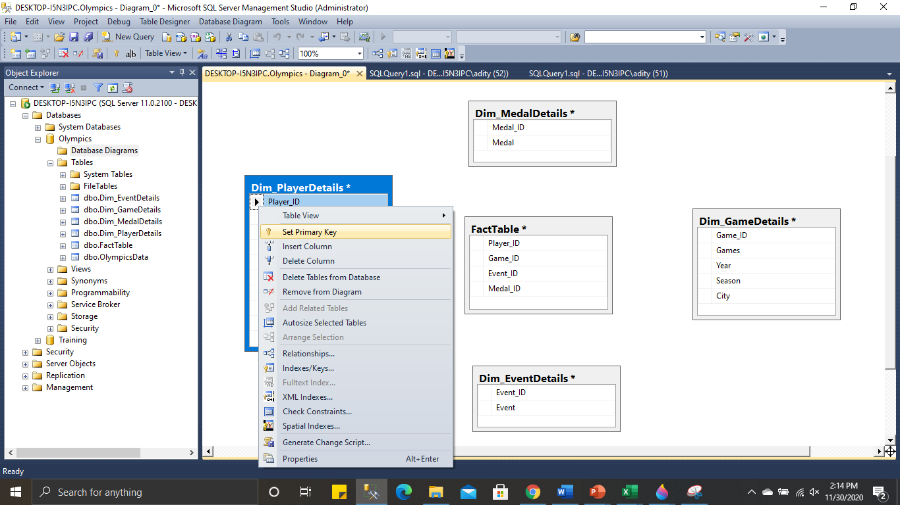
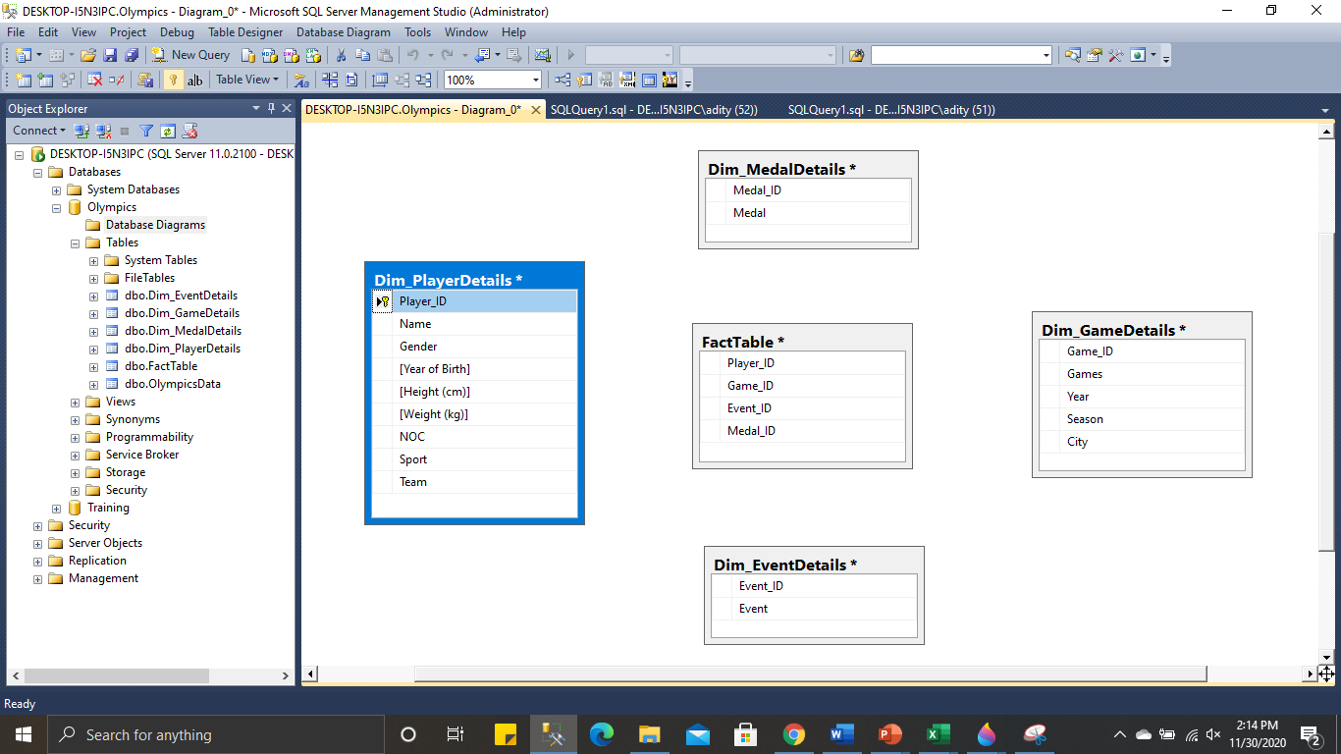
Declaring IDs as Primary key for every Dimension Table

Slide 21
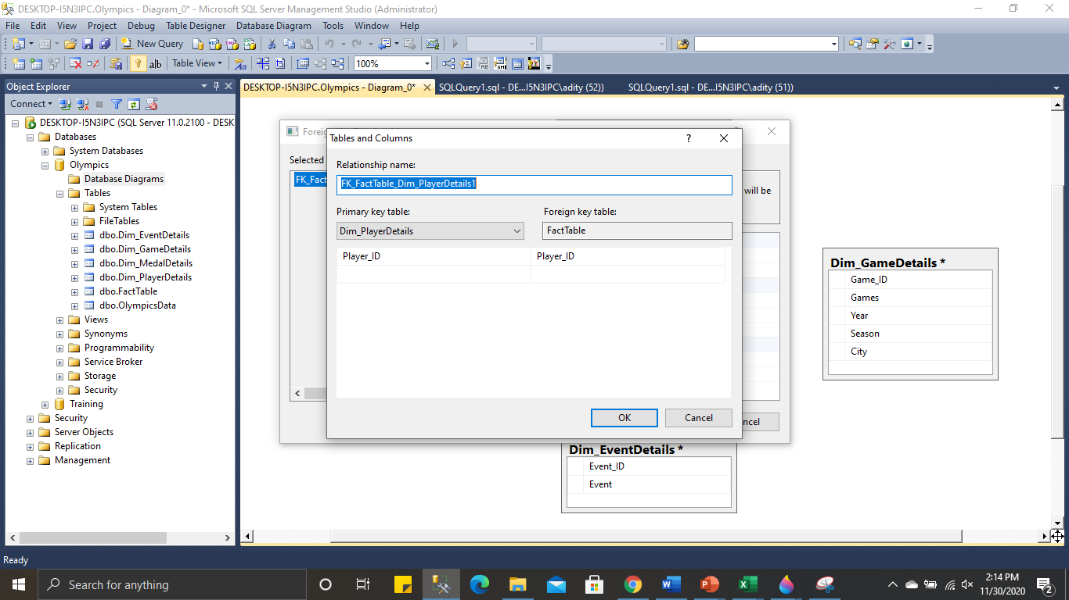
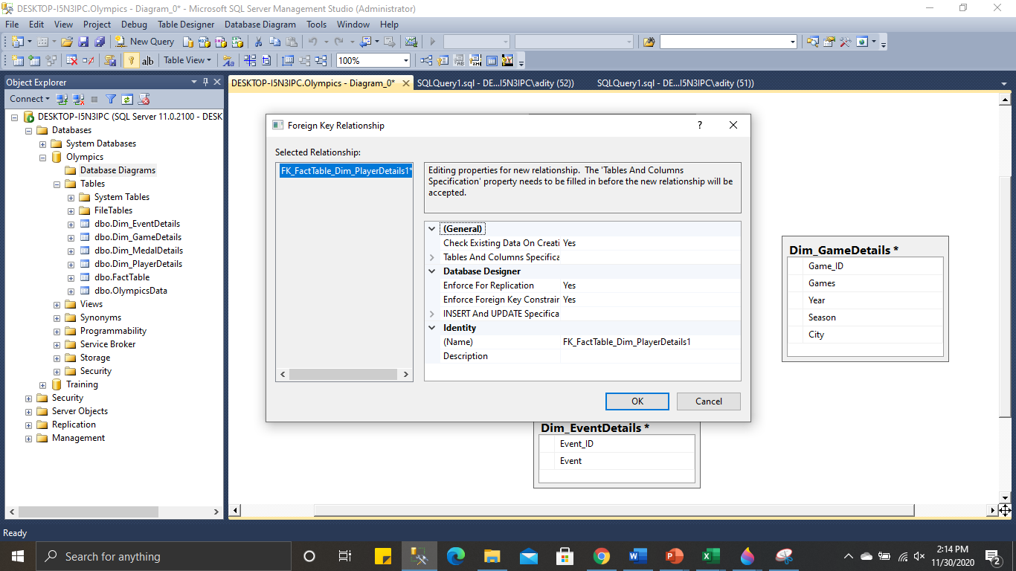
Define Relationship for every Dimension Table, by dragging the Primary Key column with the same column in Fact Table.
After saving the database diagram, tables structure will be auto created and connections will be made in order to ensure referential integrity.

Slide 22
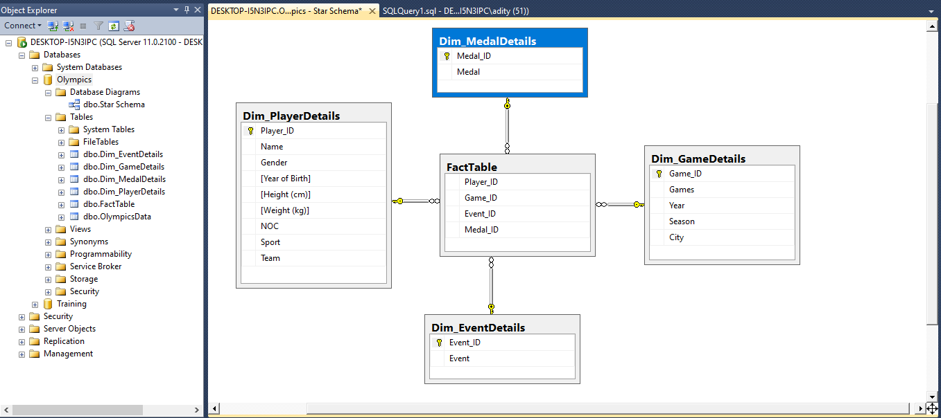
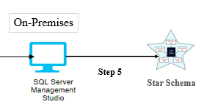
Dimensional Model

Slide 23
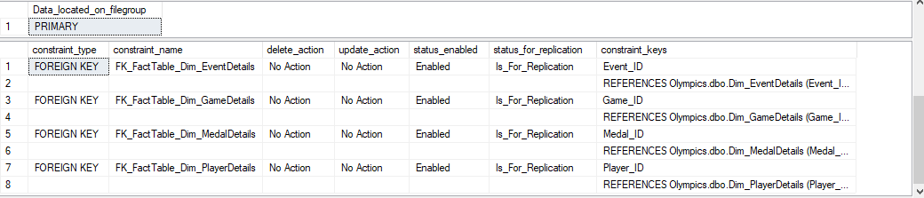
Stored Procedures
Sp_help Dim_EventDetails;
sp_help Dim_PlayerDetails;
sp_help Dim_GameDetails;
sp_help Dim_MedalDetails;
sp_help FactTable;
Check Whether the Primary keys are assigned
for each Dimension Tables and referred as foreign keys
in Fact Table to ensure referential integrity.
sp_help FactTable;

Slide 24
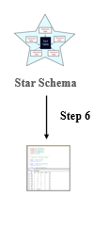
Query to join all Dimension and Fact tables
select * from Dim_PlayerDetails p
join FactTable f
on p.player_id = f.player_id
join Dim_GameDetails g
on g.game_id = f.game_id
join Dim_EventDetails e
on e.event_id = f.event_id
join Dim_MedalDetails m
on m.medal_id = f.medal_id;
By comparing, we get same no. of rows
Retrieving
data
Query to get all data from OlympicsData
select * from OlympicsData
order by Player_id;

Slide 25
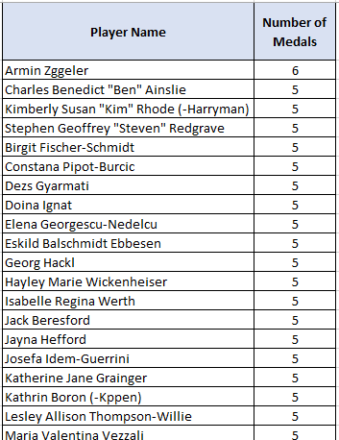
2. Aggregations on Medals
Medals won by player
select Name as [Player Name], count(Medal) as [Number of Medals]
from Dim_PlayerDetails p
join FactTable f
on p.player_id = f.player_id
join Dim_GameDetails g
on g.game_id = f.game_id
join Dim_EventDetails e
on e.event_id = f.event_id
join Dim_MedalDetails m
on m.medal_id = f.medal_id
where medal in ('Gold','Silver','Bronze')
Group by name
Order by [Number of Medals] desc;

Slide 26
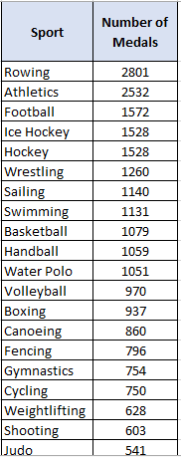
2. Aggregations on Medals
Medals won in a particular Sport
select Sport, count(Medal) as [Number of Medals] from Dim_PlayerDetails p
join FactTable f on p.player_id = f.player_id
join Dim_GameDetails g on g.game_id = f.game_id
join Dim_EventDetails e on e.event_id = f.event_id
join Dim_MedalDetails m on m.medal_id = f.medal_id
where medal in ('Gold','Silver','Bronze’) Group by sport Order by [Number of Medals] desc;

Slide 27
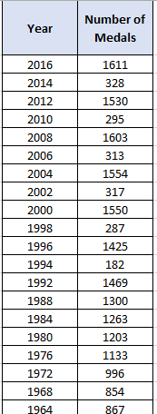
2. Aggregations on Medals
Medals won in Year
select [Year], count(Medal) as [Number of Medals]
from Dim_PlayerDetails p join FactTable f on p.player_id = f.player_id
join Dim_GameDetails g on g.game_id = f.game_id join Dim_EventDetails e on e.event_id = f.event_id
join Dim_MedalDetails m on m.medal_id = f.medal_id where medal in ('Gold','Silver','Bronze’) Group by [year] Order by [year] desc;

Slide 28
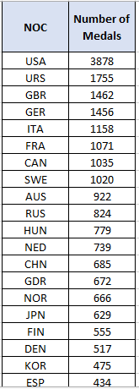
2. Aggregations on Medals
Medals won by Country
select NOC, count(Medal) as [Number of Medals] from Dim_PlayerDetails p join FactTable f
on p.player_id = f.player_id join Dim_GameDetails g on g.game_id = f.game_id join Dim_EventDetails e
on e.event_id = f.event_id join Dim_MedalDetails m on m.medal_id = f.medal_id
where medal in ('Gold',’Silver','Bronze’) Group by NOC Order by [Number of Medals] desc;

Slide 29
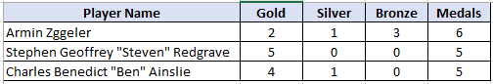
3. Top 3 Players with MAX medal
select top(3) * from (select Name as [Player Name], count(case when Medal='Gold' then 1 end) as Gold,
count(case when Medal='Silver' then 1 end) as Silver,
count(case when Medal='Bronze' then 1 end) as Bronze, count(medal) as Medals
from Dim_PlayerDetails p
join FactTable f on p.player_id = f.player_id
join Dim_GameDetails g on g.game_id = f.game_id
join Dim_EventDetails e on e.event_id = f.event_id
join Dim_MedalDetails m on m.medal_id = f.medal_id
where medal in ('Gold','Silver','Bronze’) Group by name) as Medal
Order by Medals desc, gold desc, silver desc, bronze desc;

Slide 30
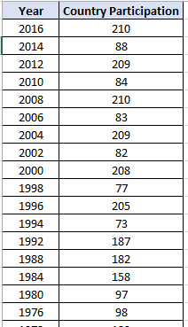
4. Country Participation in Olympic over Year
select [Year], count(distinct NOC) as [Country Participation]
from Dim_PlayerDetails p
join FactTable f on p.player_id = f.player_id join Dim_GameDetails g on g.game_id = f.game_id
join Dim_EventDetails e on e.event_id = f.event_id join Dim_MedalDetails m on m.medal_id = f.medal_id
Group by [Year] Order by [Year] desc;

Slide 31
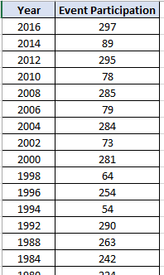
5. Event Participation over Year
select [Year], count(Distinct Event) as [Event Participation] from Dim_PlayerDetails p
join FactTable f on p.player_id = f.player_id join Dim_GameDetails g on g.game_id = f.game_id
join Dim_EventDetails e on e.event_id = f.event_id join Dim_MedalDetails m on m.medal_id = f.medal_id
Group by [Year]
Order by [Year] desc;

Slide 32
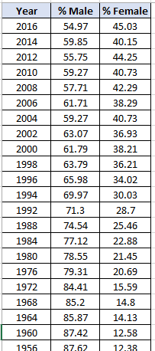
6. Ratio of Athletes Participation by gender over Year
Select [Year], left(round(Male*100.0/gender, 2),5) as [% Male], left(round(Female*100.0/gender,2),5) as [% Female] from (select [Year], count(gender) as Gender, count(case when gender='Male' then 1 end) as Male,
count(case when gender='Female' then 2 end) as Female
from Dim_PlayerDetails p
join FactTable f on p.player_id = f.player_id
join Dim_GameDetails g on g.game_id = f.game_id
join Dim_EventDetails e on e.event_id = f.event_id
join Dim_MedalDetails m on m.medal_id = f.medal_id Group by [Year]) as Gender order by [Year] desc;

Slide 33
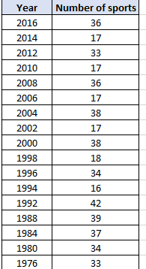
7. Year wise Sport Analysis
Sport played over year
select [Year], count(Distinct sport) as [Number of sports]
from Dim_PlayerDetails p
join FactTable f on p.player_id = f.player_id
join Dim_GameDetails g on g.game_id = f.game_id
join Dim_EventDetails e on e.event_id = f.event_id
join Dim_MedalDetails m on m.medal_id = f.medal_id
Group by [Year] Order by [Year] desc;

Slide 34
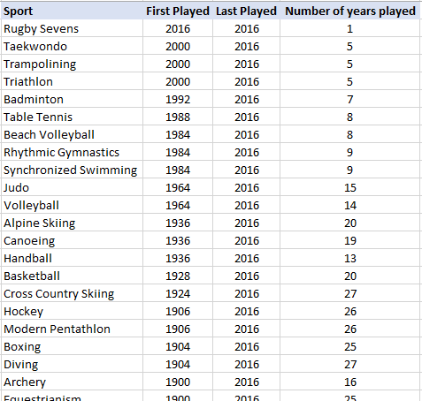
7. Year wise Sport Analysis
Sport First Played, Last Played in which year
select Sport, Min([year]) as [First Played], Max([year]) as [Last Played], count( distinct [year]) as [Number of years played]
from Dim_PlayerDetails p
join FactTable f
on p.player_id = f.player_id
join Dim_GameDetails g
on g.game_id = f.game_id
join Dim_EventDetails e
on e.event_id = f.event_id
join Dim_MedalDetails m
on m.medal_id = f.medal_id
group by sport
order by [Last Played] desc, [First Played] desc, sport asc ;

Slide 35
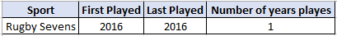
8. Newest Sport in Olympics
select top (1) * from (select Sport, Min([year]) as [First Played], Max([year]) as [Last Played], count( distinct [year]) as [Number of years playes]
from Dim_PlayerDetails p
join FactTable f
on p.player_id = f.player_id
join Dim_GameDetails g
on g.game_id = f.game_id
join Dim_EventDetails e
on e.event_id = f.event_id
join Dim_MedalDetails m
on m.medal_id = f.medal_id
group by sport) as Sports
order by [Number of years playes] asc, [Last Played] desc, [First Played] desc;

Slide 36
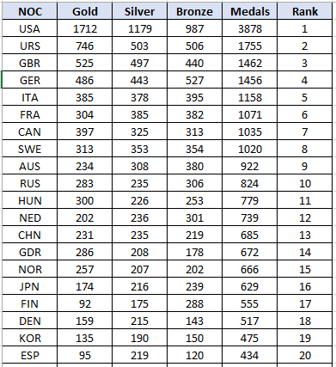
9. Rank of country on the basis of medals
select NOC, count(case when Medal='Gold' then 1 end) as Gold,
count(case when Medal='Silver' then 1 end) as Silver,
count(case when Medal='Bronze' then 1 end) as Bronze, count(medal) as Medals,
DENSE_RANK() over (Order by count(medal) desc,
count(case when Medal='Gold' then 1 end) desc,
count(case when Medal='Silver' then 1 end) desc, count(case when Medal='Bronze' then 1 end) desc ) as Rank
from Dim_PlayerDetails p
join FactTable f
on p.player_id = f.player_id
join Dim_GameDetails g
on g.game_id = f.game_id
join Dim_EventDetails e
on e.event_id = f.event_id
join Dim_MedalDetails m
on m.medal_id = f.medal_id where medal in ('Gold','Silver','Bronze’) Group by NOC
Order by Medals desc, gold desc, silver desc, bronze desc;

Slide 37

10. Comparison b/w country over medals
select [Year], NOC, count(medal) as [Number of medals]
from Dim_PlayerDetails p
join FactTable f
on p.player_id = f.player_id
join Dim_GameDetails g
on g.game_id = f.game_id
join Dim_EventDetails e
on e.event_id = f.event_id
join Dim_MedalDetails m
on m.medal_id = f.medal_id
where medal in ('Gold','Silver','Bronze')
group by [Year], NOC
order by [year] desc, [Number of medals] desc;

Slide 38

Fact & Dimension Tables
Challenges
To connect dimension and fact table
after declaring primary keys
7
6
Creating Star Schema
Define Relationship among
fact and dimension table like one to many or many to one.
5
Partition of Facts
and Dimension tables
4
3
Using
Expression Builder
Using Schema Modifier
like Aggregate, Derived Column
2
1
Creating Dataflow
Raw Data

Slide 39


Reflections
This case study helped us to learn about –
How to use correct naming conventions
How to inter-relate between different Azure services
How to create dataflow to clean the data
How to create fact and dimension Tables in dataflow
How to define relationship among facts and dimension tables using rank function
How to create Star Schema and relate fact and dimension tables
How to retrieve data from fact and dimension tables using query

Slide 40
Conclusion
In this Project, we are using ETL approach. But we can improvise it using ELT approach as ELT is more efficient and flexible than ETL.
Criteria | ETL Approach | ELT Approach
Time - Load | Uses staging area, extra time to load data | All in one system, load only once
Time – Transformation | Need to wait, especially for big data sizes - as data grows, transformation time increases | All in one system, speed is not dependent on data size
Time - Maintenance | High maintenance - choice of data to load and transform and must do it again if deleted or want to enhance the main data repository | Low maintenance - all data is always available
Usability | Used mainly by IT | Usable by everyone from developer to citizen integrator
Cost-effective | Not cost-effective for small and medium businesses | Scalable and available to all business sizes using online SaaS solutions

Slide 41
Thank You
FOR YOUR ATTENTION

